Slide 1
CNNs in Medicine: Beyond Classification June 27, 2020
MMCi Applied Data Science
Matthew Engelhard
Notes:
NEED INFO ABOUT ROC, CONFUSION MATRIX, ETC HERE

Slide 2
Object Detection
Find objects within images and identify them

Slide 3
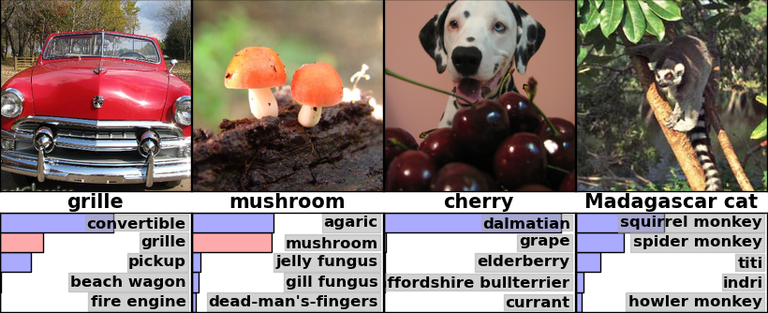
Which label is best?

Slide 4
Detection: propose regions
and predict their labels
Notes:
- Description
Typically smaller number of classes compared to classification
Result is distribution over output classes for each region
Higher annotation cost

Slide 5
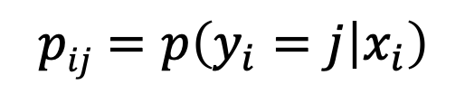
Detection Output
Number of classes C
Rows sum to 1
p_{i1} | p_{i2} | p_{i3} | p_{i4} | p_{i5} | … | p_{iC}
Variable Number of
Detected Regions of
Interest
(index omitted)
p_{i1} | p_{i2} | p_{i3} | p_{i4} | p_{i5} | … | p_{iC}
p_{i1} | p_{i2} | p_{i3} | p_{i4} | p_{i5} | … | p_{iC}
$$pij=p\left(y_{i}=j | x_{i}\right)$$
Notes:
Note: training data must match: whole-image labels

Slide 6
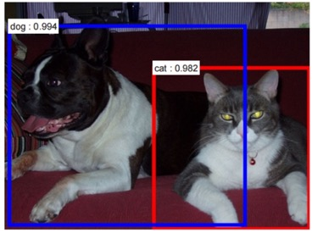
Detection Output
Number of classes C
Rows sum to 1
p_{i1} | p_{i2} | p_{i3} | p_{i4} | p_{i5} | … | p_{iC}
2 detected ROIs
(index omitted)
p_{i1} | p_{i2} | p_{i3} | p_{i4} | p_{i5} | … | p_{iC}
$$pij=p\left(y_{i}=j | x_{i}\right)$$
Notes:
Note: training data must match: whole-image labels

Slide 7
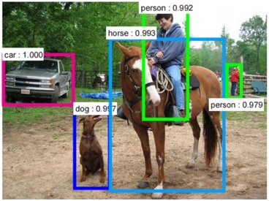
Detection Output
Number of classes C
Rows sum to 1
p_{i1} | p_{i2} | p_{i3} | p_{i4} | p_{i5} | … | p_{iC}
p_{i1} | p_{i2} | p_{i3} | p_{i4} | p_{i5} | … | p_{iC}
p_{i1} | p_{i2} | p_{i3} | p_{i4} | p_{i5} | … | p_{iC}
5 detected ROIs
(index omitted)
p_{i1} | p_{i2} | p_{i3} | p_{i4} | p_{i5} | … | p_{iC}
p_{i1} | p_{i2} | p_{i3} | p_{i4} | p_{i5} | … | p_{iC}
Notes:
Note: training data must match: whole-image labels

Slide 8
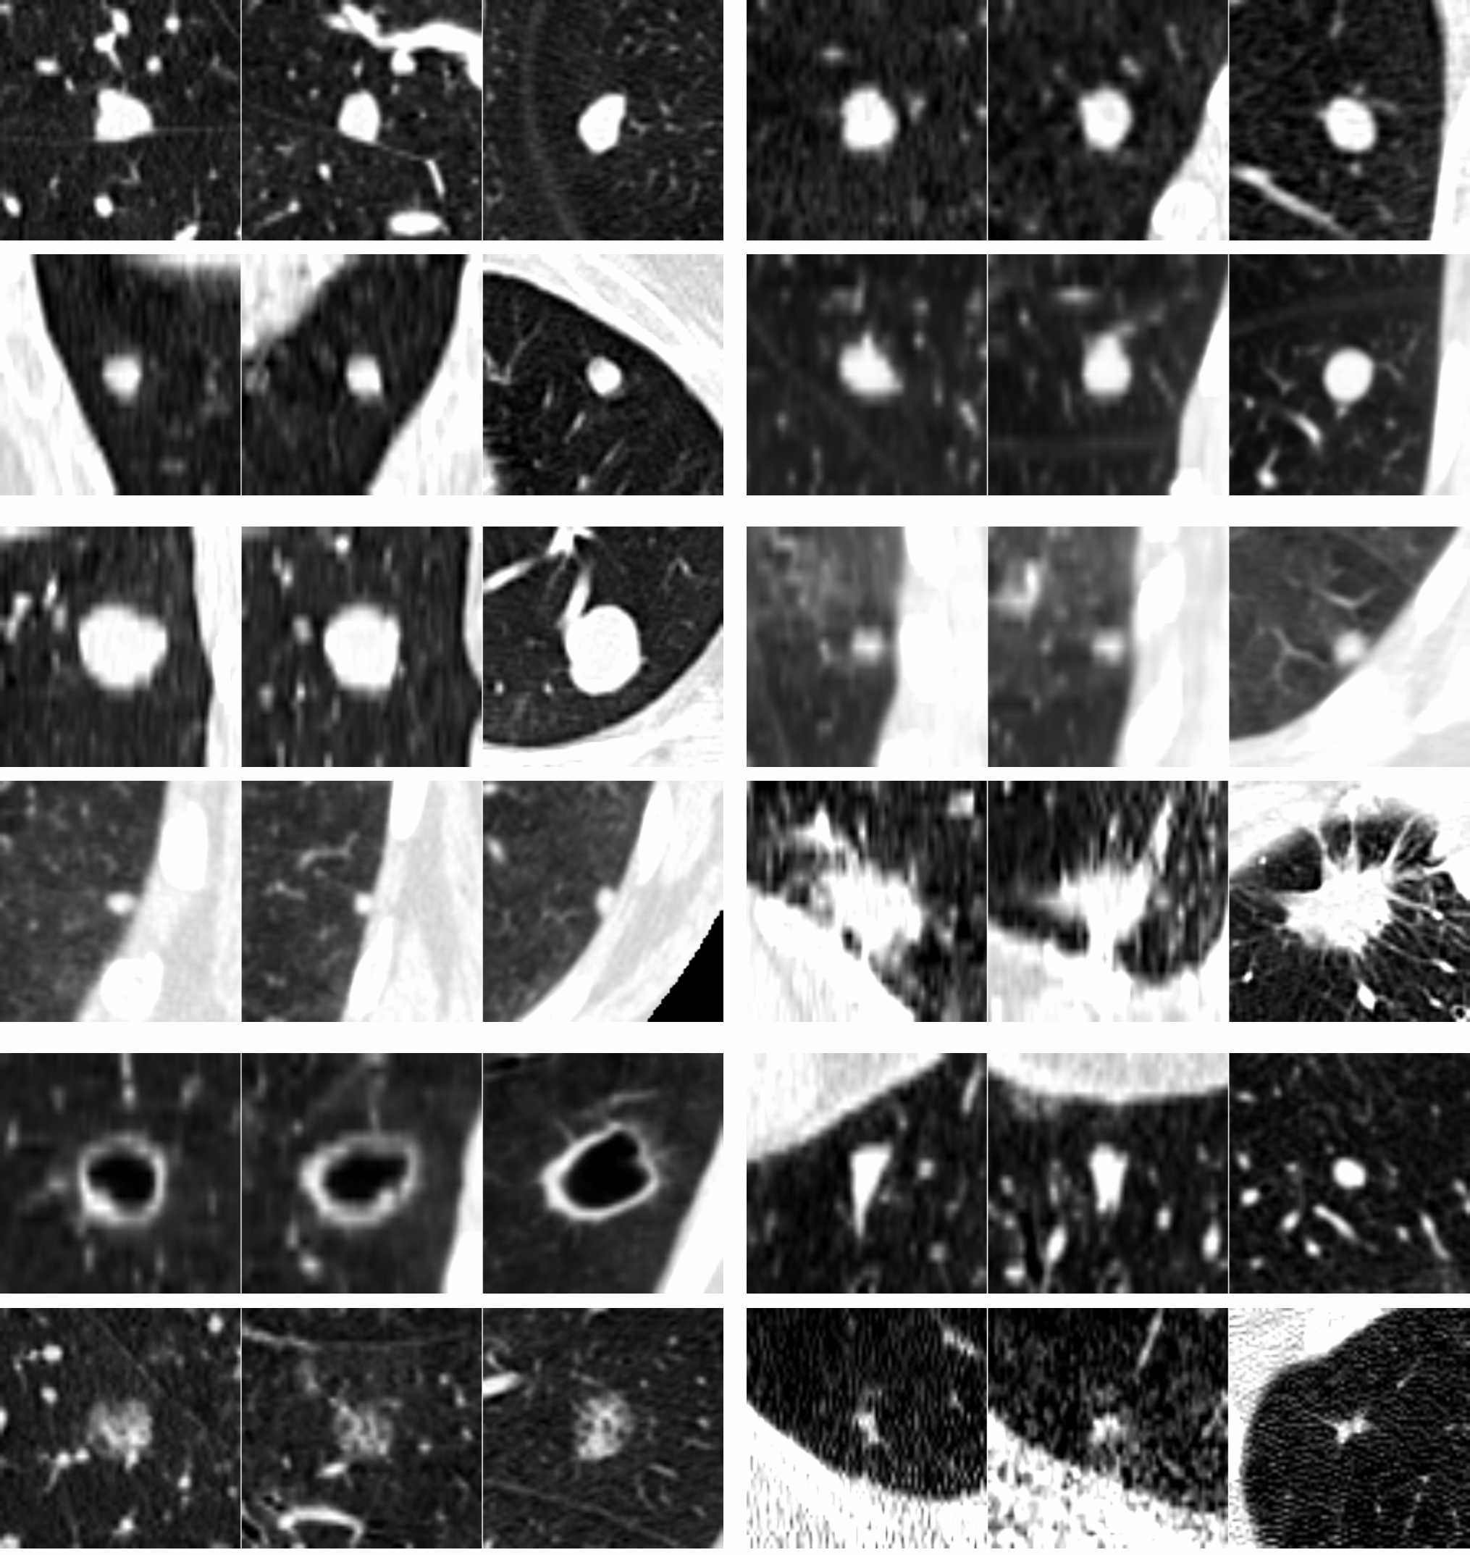
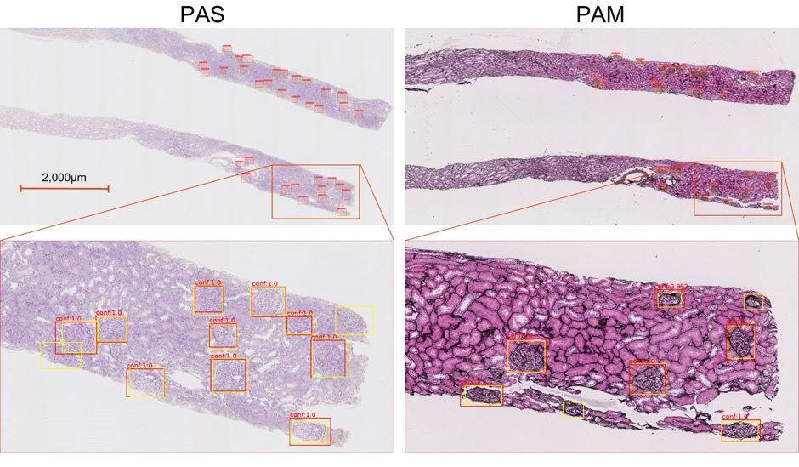
Detection in medicine
Glomerular Detection with Faster-RCNN
Pulmonary Nodule detection in CT
Kawazoe et al., J. Imaging, 2018
van Ginneken et al., Biomedical Imaging, 2015
Notes:
Adenoid cystic carcinoma (ACC) nodules (metastases)

Slide 9
Semantic Segmentation
Divide the image into meaningful regions

Slide 10
Segmentation: predict the label for each pixel
Notes:
Very high annotation cost, although can be mitigated with good tools for drawing contours
Note that it does not distinguish between distinct objects belonging to the same class (e.g. multiple chairs); newer models have been developed to deal with this

Slide 11
Segmentation of optic disc, fovea and retinal vasculature Journal of Computational Science, 20, 70-79 (2017).
Notes:
… to identify the boundaries of specific structures or regions within the retina
Identify the optic disc, the fovea, the blood vessels
When we do this, we are partitioning the image into classes
Or, view as predicting the label associated with each pixel
This is segmentation
It has also been used very effectively in medical applications
It is also primarily done with CNNs.

Slide 12
Segmentation Output: Distribution over Classes for each pixel
Number of classes
(values sum to 1)
Pixel grid (y)
Pixel grid (x)

Slide 13
Precisely Identify Boundaries

Slide 14
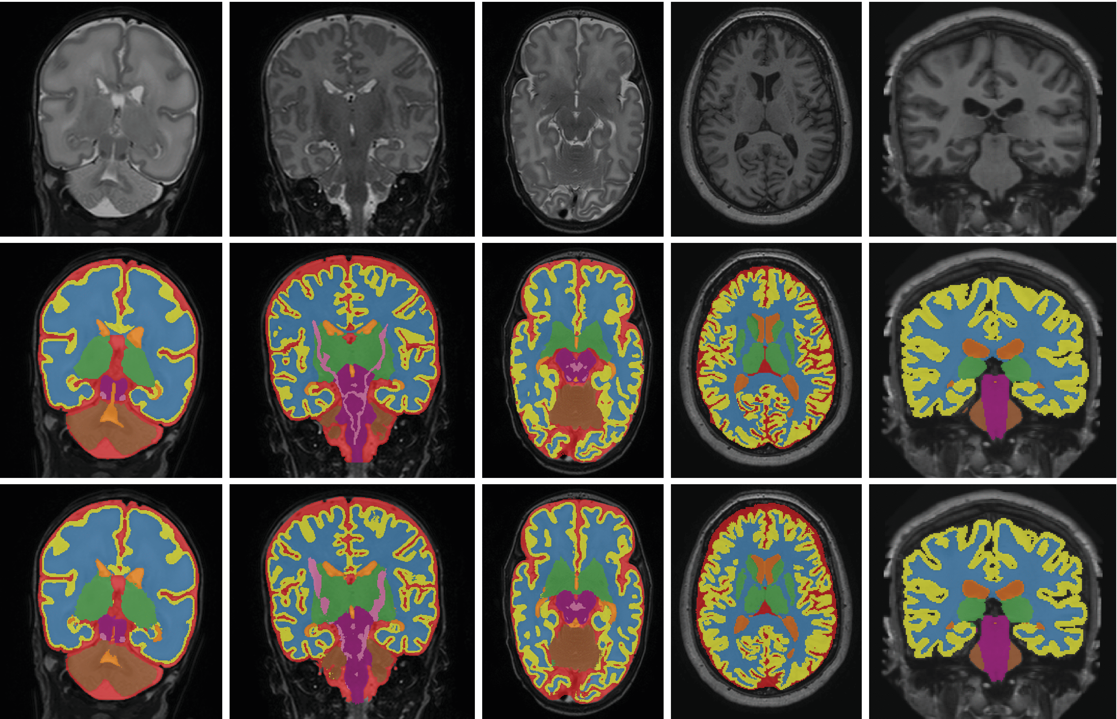
Determine Areas or Volumes
Notes:
Discuss lesion burden in MS
Tumor burden
Cardiomyopathy
Grey matter / white matter volume / volume of midbrain structures
Limit measures to specific structures

Slide 15
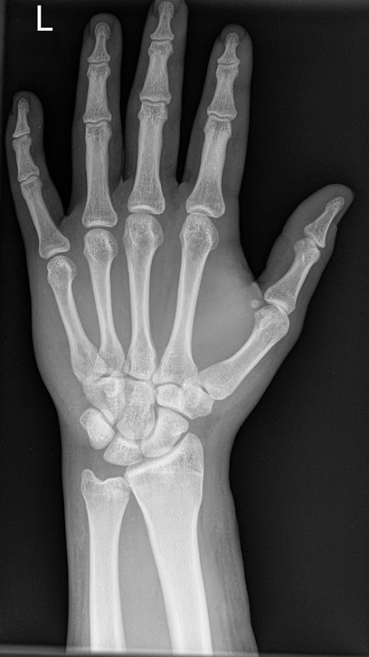
Segmentation-based features when end-to-end classification is not feasible
Segment
Bones
Calculate lengths and areas
Simple Classifier for Genetic or Growth Disorder

Slide 16

Colon Polyp Segmentation
Notes:
Show segmentation of polyps and briefly describe the clinical problem (why this matters) [10 min]
What is segmentation [15 min]
Why segment (compared to classification, detection) [5-10 min]
How does it work: two illustrative (and successful) architectures (seg-net, u-net) [10-15 min]
Evaluation of polyp segmentation / detection [10 min]
Brief discussion [<10 min]

Slide 17
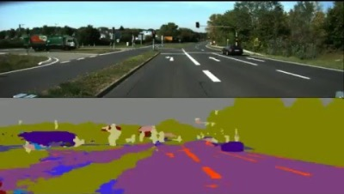
Approach: Start with SegNet (2015)

Slide 18
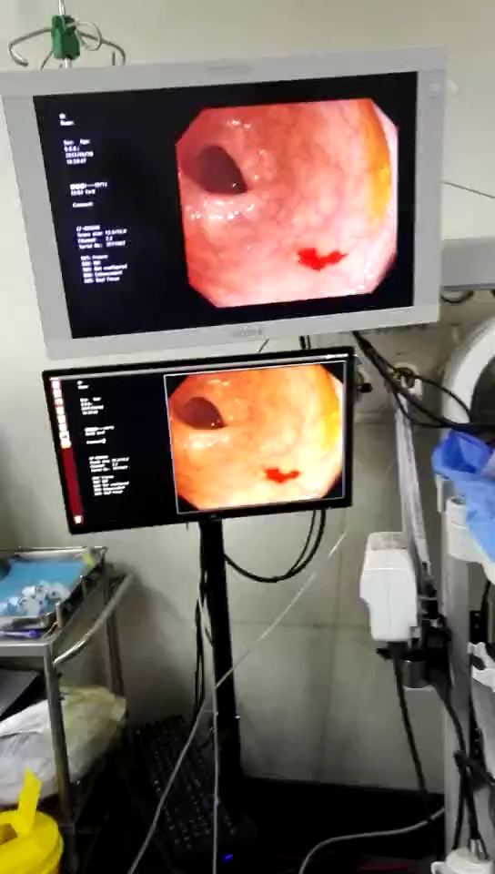
Retrain to segment polyps in real time

Slide 19
Focus on Adenomatous Polyps
BMJ 2016;354:i3590
Notes:
Colorectal cancer is the fourth most common cause of cancer related mortality globally, with 1.4 million new cases and 700 000 deaths annually.
Adenocarcinoma: >95% of colon cancer
The early ones (adenomatous) are the ones that are missed
Rarer subtypes include carcinoid tumour, sarcoma, and lymphoma

Slide 20
Why are polyps missed?
1. Never in the visual field
2. In the field, but not recognized
-> Segment polyps in real time to act as an “extra set of eyes” during colonoscopy
Notes:
-US adenoma miss rate (AMR): 6–27%
-Certain polyps may be missed more frequently, including smaller polyps, flat polyps, and polyps in the left colon.
-Several hardware innovations: panoramic camera view, distal-cap attachment
- observation of the video monitor by either nurses or gastroenterology trainees may increase polyp detection by up to 30%.
- A real-time automatic polyp-detection system could serve as an ‘extra set of eyes’
- Although automatic polyp detection in colonoscopy videos has been an active research topic for the past 20 years, performance levels close to that of the expert endoscopist have not been achieved.
- Early work in automatic polyp detection has focused on applying deep-learning techniques to polyp detection, but most published works are small in scale, with small development and/or training validation sets.
- As we will see, they use a very large dataset here.

Slide 21
4 validation datasets!!
A: new imageDB
Sichuan Provincial People’s Hospital of China, 01-12/16
27,113 images from 1,138 consecutive patients who had polyps
20% of images had polyps
Confirmed histology
Excluded poor-quality images (by panel) and >2cm masses
B: public imageDB
Hospital Clinic of Barcelona (public CVC-ClinicDB)
612 image frames from 29 colonoscopy videos
C: polyp videos
Sichuan Provincial People’s Hospital of China, 05-07/16
videos of 138 consecutively encountered polyps from 110 polyp patients
Confirmed histology
Used to assess sensitivity
D: complete videos
Sichuan Provincial People’s Hospital, 01-02/18
54 unaltered full-length colonoscopy videos from 54 patients
Used to assess specificity
Images
Video
Notes:
To note: evaluated as detection
Publicly available dataset results included (endoscopic vision challenge -- dataset B)
Video versus images

Slide 22
Performance (dataset A) How can we get a meaningful comparison to expert performance?
Notes:
Q: why is curve jagged like this?
Converting more things to be classified as positives as we move along the curve (up & right)
Move to the right: pick up another false positive (from true negative)
Move up: pick up another true positive (from false negative)
Note: no comparison to experts. Ideally we’d want to know how an expert would perform under real-world conditions – hard to simulate this.

Slide 23
Segmentation in Brief
How does it work?
Notes:
<35 minute mark

Slide 24
Classification Architecture (VGG)
Notes:
Note that this is the first half of Segnet
Visual geometry group (VGG), oxford

Slide 25
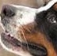
A separate classifier for each pixel?
y, associated value or label
x, data/features
End goal: predict y from x
Notes:
How does a single pixel make it a dog or not a dog?
Now imagine you don’t even know how to spot it yourself (e.g. in medical images)
Second idea: convolutional neural network with same spatial scale throughout: too many parameters!

Slide 26
Segmentation Architecture
SegNet (2015): fully convolutional architecture
Notes:
Encoder is first 13 layers of VGG
unpack this description
Each encoder layer has a corresponding decoder layer and hence the decoder network has 13 layers. The final decoder output is fed to a multi-class soft-max classifier to produce class probabilities for each pixel independently.

Slide 27
Stage 1: Encoder identifies features
Stage 2: Decoder reconstructs the spatial map
Alternative architectures differ in their approach
to the spatial reconstruction process

Slide 28
Stage 1: Encoder identifies features
Stage 2: Decoder reconstructs the spatial map
Segnet’s approach to reconstruction: remember max-pooling indices

Slide 29
SegNet decoder overview
Remember max pooling indices
Use max pooling indices
3 | 1 | 3 | 7
2 | 5 | 3 | 4
1 | 4 | 3 | 1
1 | 2 | 2 | 5
0 | 0 | 0 | 4
0 | 3 | 0 | 0
0 | 8 | 0 | 0
0 | 0 | 0 | 2
5 | 7
4 | 5
3 | 4
8 | 2
Convolution with trainable decoder filters
Other
Layers
Notes:
Talk about options here.
When we max-pool, we are remembering the most salient features; i.e. the best matches
If we want to reconstruct the original map, we should remember where these features are located

Slide 30
A Highly Successful Architecture: U-Net
Notes:
Primary differences:
1) upconvolution instead of upsampling w/pooling indices
2) append feature map from corresponding encoder

Slide 31
Concatenation of corresponding encoder feature map
Notes:
Concatenation of feature map from corresponding encoder
Adjustment for padding: take center of appropriate size

Slide 32
SegNet: Upsampling w/ Stored Pooling Indices
U-Net: 2x2 Upconvolution
0 | 0 | 0 | 4
0 | 3 | 0 | 0
0 | 8 | 0 | 0
0 | 0 | 0 | 2
3 | 4
8 | 2
3 | 4
8 | 2
1 | 3
2 | 1
Learned filter
Notes:
Double check with Justin – no overlap in field?
Note that this does not deal with depth / feature space, which is halved with each upconvolution

Slide 33
SegNet: Upsampling w/ Stored Pooling Indices
U-Net: 2x2 Upconvolution
0 | 0 | 0 | 4
0 | 3 | 0 | 0
0 | 8 | 0 | 0
0 | 0 | 0 | 2
3 | 9
6 | 3
3 | 4
8 | 2
3 | 4
8 | 2
1 | 3
2 | 1
Learned filter
Notes:
Double check with Justin – no overlap in field?
Note that this does not deal with depth / feature space, which is halved with each upconvolution

Slide 34
SegNet: Upsampling w/ Stored Pooling Indices
U-Net: 2x2 Upconvolution
0 | 0 | 0 | 4
0 | 3 | 0 | 0
0 | 8 | 0 | 0
0 | 0 | 0 | 2
3 | 9 | 4 | 12
6 | 3 | 8 | 4
3 | 4
8 | 2
3 | 4
8 | 2
1 | 3
2 | 1
Learned filter
Notes:
Double check with Justin – no overlap in field?
Note that this does not deal with depth / feature space, which is halved with each upconvolution

Slide 35
SegNet: Upsampling w/ Stored Pooling Indices
U-Net: 2x2 Upconvolution
0 | 0 | 0 | 4
0 | 3 | 0 | 0
0 | 8 | 0 | 0
0 | 0 | 0 | 2
3 | 9 | 4 | 12
6 | 3 | 8 | 4
8 | 24
16 | 8
3 | 4
8 | 2
3 | 4
8 | 2
1 | 3
2 | 1
Learned filter
Notes:
Double check with Justin – no overlap in field?
Note that this does not deal with depth / feature space, which is halved with each upconvolution

Slide 36
SegNet: Upsampling w/ Stored Pooling Indices
U-Net: 2x2 Upconvolution
0 | 0 | 0 | 4
0 | 3 | 0 | 0
0 | 8 | 0 | 0
0 | 0 | 0 | 2
3 | 9 | 4 | 12
6 | 3 | 8 | 4
8 | 24 | 2 | 6
16 | 8 | 4 | 2
3 | 4
8 | 2
3 | 4
8 | 2
1 | 3
2 | 1
Learned filter
Notes:
Double check with Justin – no overlap in field?
Note that this does not deal with depth / feature space, which is halved with each upconvolution

